Slide 1
Techniques for Big Data Processing (Google GFS, Big Table)
Cloud Computing
Present By:- Uzma Banu

Slide 2
Introduction to Big Data Processing
What is Big Data?
Large, complex datasets that traditional databases can't handle.
Requires distributed storage & parallel processing.
Challenges in Big Data Processing:
Storage: Huge volume of data.
Speed: Fast retrieval & updates required.
Scalability: Needs to support growing datasets.
Solution: Google developed GFS (Google File System) & BigTable for efficient storage & processing.

Slide 3
Google’s Big Data Technologies
Google created a three-part ecosystem for big data:
GFS (Distributed File Storage)
MapReduce (Processing Framework)
BigTable (Structured Data Storage)
These technologies handle petabytes of data efficiently.

Slide 4
Google File System (GFS) – Overview
What is GFS?
A distributed file system for large-scale data storage.
Stores data across multiple servers with redundancy.
Key Features:
Fault tolerance: Data is replicated across servers.
Scalability: Works on thousands of machines.
High throughput: Optimized for large files & batch processing.

Slide 5
GFS Architecture
Main Components of GFS:
Master Node: Manages metadata & chunk locations.
Chunk Servers: Store large files split into fixed-size chunks (64MB).
Clients: Read/write data by interacting with chunk servers via the master.

Slide 6
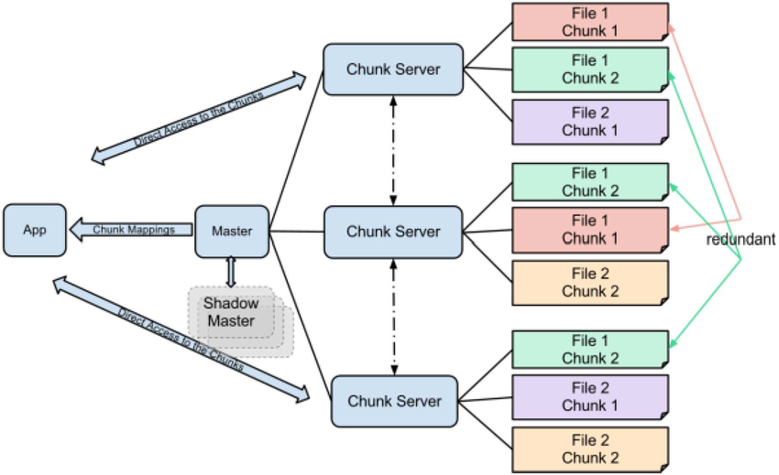
GFS architecture

Slide 7
How GFS Works
Data Storage Process:
Files split into 64MB chunks.
Each chunk is stored in multiple Chunk Servers for fault tolerance.
Metadata is stored in the Master Node.
Data Retrieval Process:
Clients request metadata from the Master.
They retrieve chunks from the nearest chunk servers.

Slide 8
Google BigTable – Overview
What is BigTable?
A distributed storage system for structured data.
Used in Google services like Gmail, Google Search, and YouTube.
Key Features:
Column-oriented storage for efficient access.
Highly scalable for petabytes of data.
Supports real-time and batch processing.

Slide 9
BigTable Architecture
Main Components of BigTable:
Tablet Servers: Store and manage table data.
Master Server: Assigns tablets and manages metadata.
Chubby Lock Service: Ensures consistency & coordination.
Data is stored as tables, where:
Rows are indexed by unique row keys.
Columns are grouped into column families.
Timestamps help track data versions.

Slide 10
How BigTable Works
Data Write Process:
Data is stored in SSTables (Sorted String Tables).
A commit log ensures durability.
Memtables & LSM Trees (Log-Structured Merge Trees) help optimize read/write operations.
Data Read Process:
Reads merge data from Memtables & SSTables.
Uses Bloom Filters for fast lookups.

Slide 11
Conclusion & Comparison
Feature | Google File System (GFS) | BigTable
Purpose | Distributed file storage | Structured data storage
Data Model | Large files split into chunks | Tables with rows, columns & timestamps
Optimization | High throughput, large file handling | Fast reads/writes, real-time queries
Use Cases | Google Drive, YouTube | Google Search, Gmail, Google Analytics

Slide 12
Thank You…!

